Slide 1
Health of Banking in India Private and public banks
Shivan Bhura - A001
Taksh Mathur- A011
Krishi Awasthi - A020
Sanat Mishra- A041
Smridhi Sachdev - A047

Slide 2
Index
1. Introduction | 8. Comparative Analysis
2. Role of hypothesis testing in Banking Industry | 9. Test and their formulas
3. Literature Review | 10. Hypothesis Testing
4. Objectives | 11. Conclusion
5. Ratios | 12. Limitation
6. Dataset | 13. Bibliography
7. Descriptive Analysis

Slide 3
Introduction
Health of banking in India remains a topic of scrutiny and reform amidst ongoing challenges and transformations.
The sector has shown resilience in adapting to regulatory changes and technological advancements, yet it grapples with issues like non-performing assets (NPAs), governance concerns, and liquidity constraints.
The Reserve Bank of India (RBI) continues to implement measures to strengthen the stability and efficiency of banks through initiatives like prompt corrective action (PCA) frameworks and capital adequacy norms.
Additionally, the emergence of digital banking and fintech innovations presents both opportunities and challenges for traditional banking institutions.

Slide 4
Role of Hypothesis testing on Health of Banking:
Trend Identification: Hypothesis testing reveals trends in financial indicators like capital adequacy and asset quality over time, highlighting potential risks or opportunities.
Performance Comparison: It facilitates comparisons of bank performance, assessing metrics like profitability and risk management across different banks or groups.
Regulatory Compliance: Tests gauge compliance with banking regulations, ensuring adherence to standards on capital, liquidity, and risk management.
Risk Factor Identification: By examining relationships between risk factors (e.g., economic indicators) and financial indicators, it identifies potential risks affecting banking health.
Decision Support: Hypothesis testing guides strategic decisions, informing planning, risk management, and resource allocation within banks and the industry.

Slide 5
Literature Review
Every bank wants to showcase a healthy balance sheet at the end of every financial year. But unfortunately, combination of NPAs and restructured assets, that is, stressed assets, has ruined the situation. | (Garg, 2019)
The de-branching of banks is currently one of the most fundamental changes in the industry, affecting all types of banks and branches. Branches are proxies for lending relationships, information asymmetries, loan portfolio distributions, and/or exposure to de- posit flows. | (Keil & Ongena, 2024)
Liberalization in Indian economy has brought competition among banks, at domestic level as well as foreign level. Due to intense competition both among domestic and foreign banks, rapid speed of innovations and introduction of new financial instruments, changing consumer’s demands have changed the way a bank does business and services its customers. | (Ordia & Bhanawat, 2018)
Banking sector in India has the advantage of access to one of the largest and most stable global financial networks. The potential growth of the banking sector stems from the fact that only 15 percent of the population has ever borrowed from banks, and more than 40 percent do not even have bank accounts. | (N, 2022)

Slide 6
Objectives
Descriptive analysis: Providing a comprehensive overview of key financial ratios (NIM, ICR, CAR, NPA, LTD) for both private and public sector banks over multiple years (2018-2023).
Assessing Differences: Determining whether there are significant differences in key financial ratios between private and public sector banks. This involves comparing measures such as Net Interest Margin (NIM), Interest Coverage Ratio (ICR), Capital Adequacy Ratio (CAR), Non-Performing Assets Ratio (NPA), and Loan to Deposit Ratio (LTD) between the two sectors.
Temporal Analysis: Examining whether there are significant changes in financial ratios over time within each sector and across sectors. This analysis helps in identifying trends and understanding how the financial health of banks evolves over the years.
Non-parametric hypothesis testing: Analyzing the banking industry's health using statistical methods that do not rely on specific assumptions about the data distribution, allowing for robust comparisons and inferences.

Slide 7
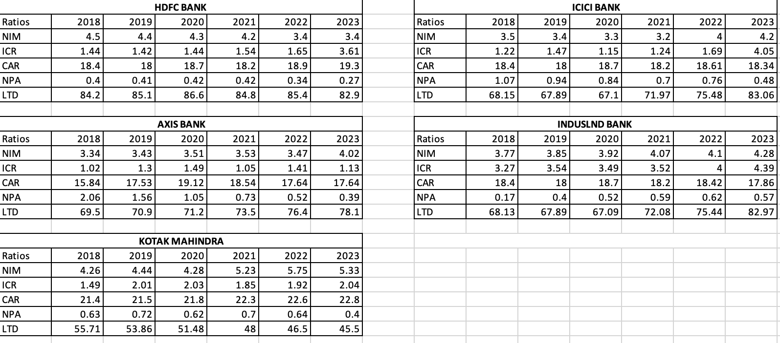
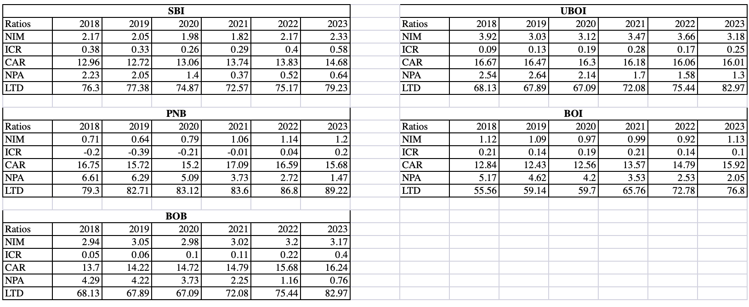
Dataset
Private Banks
Public Banks

Slide 8
Ratios that are used in the analysis:
NIM (Net Interest Margin): Profitability measure showing the difference between interest income and interest expenses.
ICR (Interest Coverage Ratio): Financial gauge of a company's ability to cover interest payments with earnings.
CAR (Capital Adequacy Ratio): Regulatory indicator assessing a bank's capital relative to its risk-weighted assets.
LTD (Loan to Deposit Ratio): Ratio indicating the proportion of a bank's loans to its deposits, reflecting its lending activities relative to its deposit base.
NPA (Non-Performing Asset): Loans with overdue payments, usually 90 days or more, indicating potential default.

Slide 9
Private Sector Banks
HDFC Bank consistently maintained low NPA ratios over the years.
ICICI Bank experienced fluctuations in NPA, possibly indicating varying asset quality.
AXIS Bank showed relatively low NPA ratios, suggesting effective risk management practices.
INDUSLAND Bank maintained a stable or decreasing trend in NPA ratios, indicating robust asset quality.
KOTAK Bank displayed moderate NPA ratios, with a slight increase over the years, suggesting potential challenges in managing non-performing assets.
YES Bank had high NPA ratios, with fluctuations over the years, indicating significant challenges in asset quality management.
HDFC Bank consistently maintained a high Loan to Deposit (LTD) ratio over the years, indicating efficient utilization of deposits for lending activities.
ICICI Bank showed fluctuations in LTD, possibly reflecting variations in its loan portfolio relative to deposit levels.
AXIS Bank demonstrated relatively stable LTD ratios, suggesting a consistent approach to managing loan and deposit balances.
INDUSLAND Bank exhibited a decreasing trend in LTD ratios, indicating a conservative approach to lending relative to deposit levels.
KOTAK Bank displayed a declining trend in LTD ratios, possibly indicating a shift towards a more conservative lending strategy.
YES Bank showed fluctuating LTD ratios, suggesting potential challenges in managing loan and deposit balances efficiently.

Slide 10
Public Sector Banks
SBI displayed varying NPA ratios over the years, possibly reflecting challenges in managing asset quality across its extensive loan portfolio.
UBOI demonstrated relatively low NPA ratios, indicating effective risk management practices despite being a public sector bank.
PNB exhibited fluctuating NPA ratios, suggesting challenges in maintaining asset quality consistently over the years.
BOI and BOB showed higher NPA ratios, indicating potential issues with loan quality and credit risk management within these public sector banks.
SBI consistently kept its LTD ratio at relatively low levels over the years, reflecting a cautious approach to lending in proportion to its deposit base.
UBOI displayed LTD ratios that were generally lower than those of private sector banks, indicating a conservative stance in utilizing deposits for lending activities.
PNB showed LTD ratios that remained relatively stable over the years, suggesting a balanced approach to managing loan and deposit levels.
BOI and BOB exhibited LTD ratios that were conservative compared to private sector banks, possibly reflecting a risk-averse lending strategy and prudent deposit management practices.

Slide 11
Comparative Analysis
1. Net Interest Margin (NIM):
Analysis: Private banks generally exhibit higher NIM compared to public banks, indicating better efficiency in generating income from interest-bearing assets.
2. Interest Coverage Ratio (ICR):
Analysis: Private banks tend to have higher ICR, reflecting their better ability to cover interest payments with operating income compared to public banks.
3. Capital Adequacy Ratio (CAR):
Analysis: Private banks generally maintain higher CAR, indicating stronger financial health and ability to absorb losses compared to public banks.
4. Non-Performing Assets Ratio (NPA):
Analysis: Public banks tend to have slightly higher NPA compared to private banks, suggesting a relatively higher proportion of assets at risk of default.
5. Loan to Deposit Ratio (LTD):
Analysis: Public banks generally have higher LTD, indicating a larger proportion of loans funded by deposits compared to private banks.

Slide 12
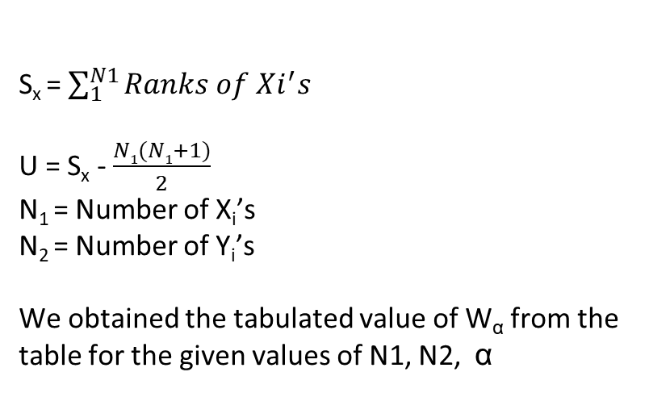
Test and their respective formulas used:
(Mann-Whitney U-Test)
Statistical Test
Rejection Criteria
S_{x} = $\sum_{1}^{N1}{Ranks of Xi^{′}s}$
U = S_{x} - $\frac{N1(N1+1)}{2}$
N₁ = Number of X_{i}’s
N₂ = Number of Y_{i}’s
We obtained the tabulated value of W_{α} from the table for the given values of N1, N2, α
For
H₀ : F(X) = G(Y)
H₁ : F(X) > G(Y) i.e. M_{x} < M_{y}
Reject H₀ if U < W_{⍺, N1, N2}
For
H₀ : F(X) = G(Y)
H₁ : F(X) < G(Y) i.e. Mx > My
Reject H₀ if U > W_{1-⍺, N1, N2} [W_{1-⍺}=N1.N2 – W_{α}]
For
H₀ : F(X) = G(Y)
H₁ : F(X) ≠ G(Y) i.e. M_{x} ≠ M_{y}
Reject H₀ if U < W_{⍺/2, N1, N2} or U > W_{1-⍺/2, N1, N2}

Slide 13
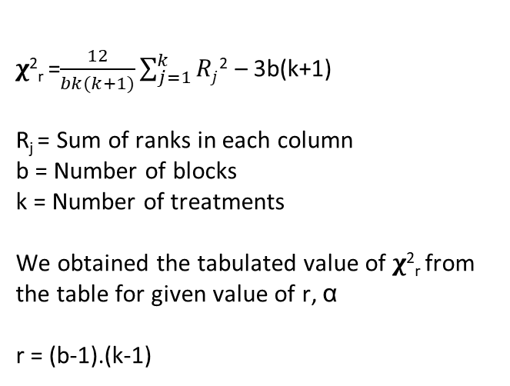
Test and their respective formulas used:
(Freidman Two Way Analysis by Ranks)
Statistical Test
Rejection Criteria
𝛘²_{r} =$\frac{12}{bk(k+1)}\sum_{j=1}^{k}{Rj}$² – 3b(k+1)
R_{j} = Sum of ranks in each column
b = Number of blocks
k = Number of treatments
We obtained the tabulated value of 𝛘²_{r} from the table for given value of r, α
r = (b-1).(k-1)
H₀ : Population within a block are identical.
H₁ : Atleast one treatment tends to yield larger values than atleast one treatment.
Case1: When b&k are small we use Friedman table.
Reject H₀ if 𝛘²_{r cal} > 𝛘²_{r(table)}
Do not reject otherwise.
Case 2: When tabulated values are not available.
Reject H₀ if 𝛘²_{r cal}> 𝛘²_{k-1,1-𝝰}
Do not reject otherwise.

Slide 14

Test and their respective formulas used:
(Paired Sample Sign Test)
Rejection Criteria
Statistical Test
For
H₀ : Mx = My
H₁ : Mx > My
Reject H₀ if T⁻$≤$ d₁
For
H₀ : Mx = My
H₁ : Mx < My
Reject H₀ if T⁺ $≤$d₂
For
H₀ : Mx = My
H₁ : Mx ≠ My
Reject H₀ if T $≤$ d
T⁺= No. of positive signs
T⁻= No. of negative signs
We obtained the tabulated value of d₁ from the table for the given value of α , n

Slide 15
Test for mean of NIM (Net Interest Margin):
(Mann-Whitney U-Test)
Private vs Public
H₀ : F(X) = G(Y)
H₁ : F(X) < G(Y) i.e. Mx > My
X : Private Sector Sample
Y : Public Sector Sample
Level of Significance = 0.05
Since,
U > W_{1-α}
Therefore we reject null hypothesis
Conclusion: Under H₀ we expect larger number of Yj’s which are less than Xi’s. Therefore, Private sector NIM is larger than the NIM of Public Sector banks.
This implies that private sector banks might be more efficient in managing their interest income and expenses, leading to a higher margin between the interest earned on assets and the interest paid on liabilities.
Mx | 3.998333
My | 2.086667
N1 | 5
N2 | 5
Sx | 40
U | 25
W_{1-α,} | 20

Slide 16
Test for ICR (Interest Coverage Ratio):
(Freidman Two Way Analysis by Ranks)
Private Banks
H₀ : There is no significant difference in the ICR among the private banks across the years
H₁ : There is significant difference in the ICR among the private banks across the years
Level of Significance = 0.05
k | 5
b | 6
R1 | 15
R2 | 15
R3 | 8
R4 | 30
R5 | 22
Freidman test statistic | 18.5333
𝛘²₂₀ | 10.85081
Since,
𝛘²_{r cal} > 𝛘²_{r(table)}
Therefore, we will reject null hypothesis
Conclusion: There are significant variations in the ICR of different private sectors banks (HDFC, ICICI, AXIS, INDUSLAND, KOTAK) over the years 2018 to 2023.
This suggests that the performance in terms of ICR varies significantly across these banks during this time period. Further analysis or investigation may be warranted to understand the specific factors contributing to these differences.

Slide 17
Test for ICR (Interest Coverage Ratio):
(Freidman Two Way Analysis by Ranks)
Public Banks
H₀ : There is no significant difference in the ICR among the public banks across the years
H₁ : There is significant difference in the ICR among the public banks across the years
Level of Significance = 0.05
Since,
𝛘²_{r cal} > 𝛘²_{r(table)}
Therefore, we will reject null hypothesis
Conclusion: There are significant variations in the ICRs of different public sector banks (SBI, UBOI, PNB, BOI, BOB) over the years 2018 to 2023.
This suggests that the financial health and ability to cover interest expenses differ significantly among these banks during this time period. Further investigation may be necessary to understand the underlying factors driving these differences.
k | 5
b | 6
R1 | 30
R2 | 20.5
R3 | 7.5
R4 | 15
R5 | 17
Freidman test statistic | 18.152
𝛘²₂₀ | 10.85081

Slide 18
Test for ICR (Interest Coverage Ratio):
(Mann-Whitney U-Test)
Private (Worst) vs Public (Best)
Since,
U > W_{1-α}
Therefore, we reject null hypothesis
Conclusion: Under H₀ we expect larger number of Yj’s which are less than Xi’s. This implies that there is a statistically significant difference in the Interest Coverage Ratio (ICR) between private sector bank (AXIS) and public sector bank (SBI).
Further analysis suggests that AXIS which is the worst private sector bank for ICR, consistently demonstrates higher ICR values compared to SBI which is the best public sector bank for ICR across the years 2018 to 2023.
This indicates that AXIS bank which has the lowest values of ICR ,a private sector bank, has a better ability to cover its interest expenses compared to SBI which has the highest values of ICR, a public sector bank, during the time period 2018-2023.
H₀ : F(X) = G(Y)
H₁ : F(X) < G(Y) i.e. Mx > My
X : Private worst bank in ICR Sample
Y : Public best bank in ICR Sample
Level of Significance = 0.05
Mx | 1.215
My | 0.355
N1 | 6
N2 | 6
Sx | 57
U | 36
W_{1-α,} | 28

Slide 19
Test for CAR (Capital Adequacy Ratio):
(Mann-Whitney U-Test)
Private vs Public
H₀ : F(X) = G(Y)
H₁ : F(X) < G(Y) i.e. Mx > My
X : Private Sector sample
Y : Public Sector sample
Level of Significance = 0.05
Since,
U > W_{1-α}
Therefore we reject null hypothesis
Conclusion: Under H₀ we expect larger number of Yj’s which are less than Xi’s. Therefore, Private sector CAR is larger than the CAR of Public Sector banks.
This suggests that private sector banks generally maintain a stronger capital adequacy position compared to their public sector counterparts. A higher CAR indicates that a bank has a greater buffer to absorb potential losses and risks, thereby enhancing its stability and resilience to adverse economic conditions.
Mx | 18.34
My | 15.92
N1 | 5
N2 | 5
Sx | 40
U | 25
W_{1-α,} | 20

Slide 20
Test for LTD (Loan to Deposit Ratio):
(Paired Sample sign test)
Private Bank (2022-2023)
H₀ : Mx = My
H₁ : Mx > My
X : Median Private Sector LTD
Y : Median Public Sector Sample
Level of Significance = 0.05
Since,
T⁻ > d1
Therefore, we do not reject null hypothesis
Conclusion: Hence, we can say that there are no significant changes in LTD of previous year and current year of private sector banks.
This finding implies that private sector banks have maintained relatively stable LTD levels over the considered time period. A lack of significant changes in LTD indicates that private sector banks have likely managed their loan and deposit portfolios in a consistent manner, without experiencing drastic shifts in their lending or funding activities.
Mx | 75.48
My | 82.9
T+ | 3
T- | 2
d1 | 0

Slide 21
Test for CAR (Capital Adequacy Ratio):
(Paired Sample sign test)
Public Bank (2022-2023)
H₀ : Mx = My
H₁ : Mx > My
X : Median Private Sector LTD
Y : Median Public Sector Sample
Level of Significance = 0.05
Since,
T⁻ = d1
Therefore, we will reject null hypothesis
Conclusion: Hence, we can say that there is significant changes in LTD of previous year and current year of public sector banks.
The observed changes in LTD underscore the dynamic nature of public sector banks' balance sheets and their responsiveness to evolving market dynamics and regulatory environments. It suggests that these banks have been actively managing their loan and deposit portfolios to adapt to changing circumstances and optimize their financial performance.
Mx | 82.97
My | 75.44
T+ | 5
T- | 0
d1 | 0

Slide 22
Conclusion
Private banks may exhibit greater efficiency in managing their interest income and expenses, resulting in a higher margin between interest earned on assets and interest paid on liabilities.
The Mann-Whitney U test indicates a significant difference in the Interest Coverage Ratio (ICR) between AXIS, a private sector bank, and SBI, a public sector bank. Despite AXIS consistently displaying lower ICR values, it demonstrates better ability to cover interest expenses compared to SBI, which shows higher ICR values over the period 2018-2023.
Private banks tend to maintain a stronger capital position, enhancing their stability and resilience against potential risks and losses.
Public sector banks actively manage loan and deposit portfolios , likely in response to evolving market conditions and regulatory requirements.
In summary, private banks generally outperform public sector banks across various financial ratios, indicating better asset quality, profitability, and capital adequacy. However, public sector banks play a crucial role in extending credit to the economy despite facing challenges.

Slide 23
Limitation
The data for public sector banks was not available to the public, so it had to be manually calculated, leading to many variations due to human error which can cause inconsistencies or inaccuracies in the dataset.
The dataset includes both private and public sector banks, which may differ in terms of size, operations, and regulatory environment. Comparisons between these banks may be affected by differences in their characteristics, making it challenging to draw meaningful conclusions.
The dataset relies on publicly available data, which may vary in terms of reliability and consistency across sources. Differences in data collection methods or reporting standards can introduce biases or inconsistencies in the dataset.

Slide 24
Bibliography
Garg, N. (2019). Decoding the great indian recapitalisation plan: Restoring the health of public sector banks in india. South Asian Survey, 26(1), 28–54. https://doi.org/10.1177/0971523118825393
Keil, J., & Ongena, S. (2024). The demise of branch banking – Technology, consolidation, bank fragility. Journal of Banking & Finance, 158, 107038. https://doi.org/10.1016/j.jbankfin.2023.107038
https://gh.bmj.com/content/3/Suppl_1/e000597
https://bfsi.economictimes.indiatimes.com/news/banking/indian-banking-health-fortified-by-low-npas-capital-adequacy-and-liquidity-buffers-rbi/101362139
Ali, M. A., Pervez, A., Bansal, R., & Khan, M. A. (2022). Analyzing performance of banks in india: A robust regression analysis approach. Discrete Dynamics in Nature and Society, 2022, 1–9. https://doi.org/10.1155/2022/8103510
Uppal, R. K. (2011). Comparative study of performance of indian commercial banks in the era of global melt-down. Journal of Social and Development Sciences, 1(2), 60–66. https://doi.org/10.22610/jsds.v1i2.628

Slide 25
THANK YOU!

